Slide 1
Morse Code Translator
Jacob Perry, Jessica Ramirez, Lola Shadare

Slide 2
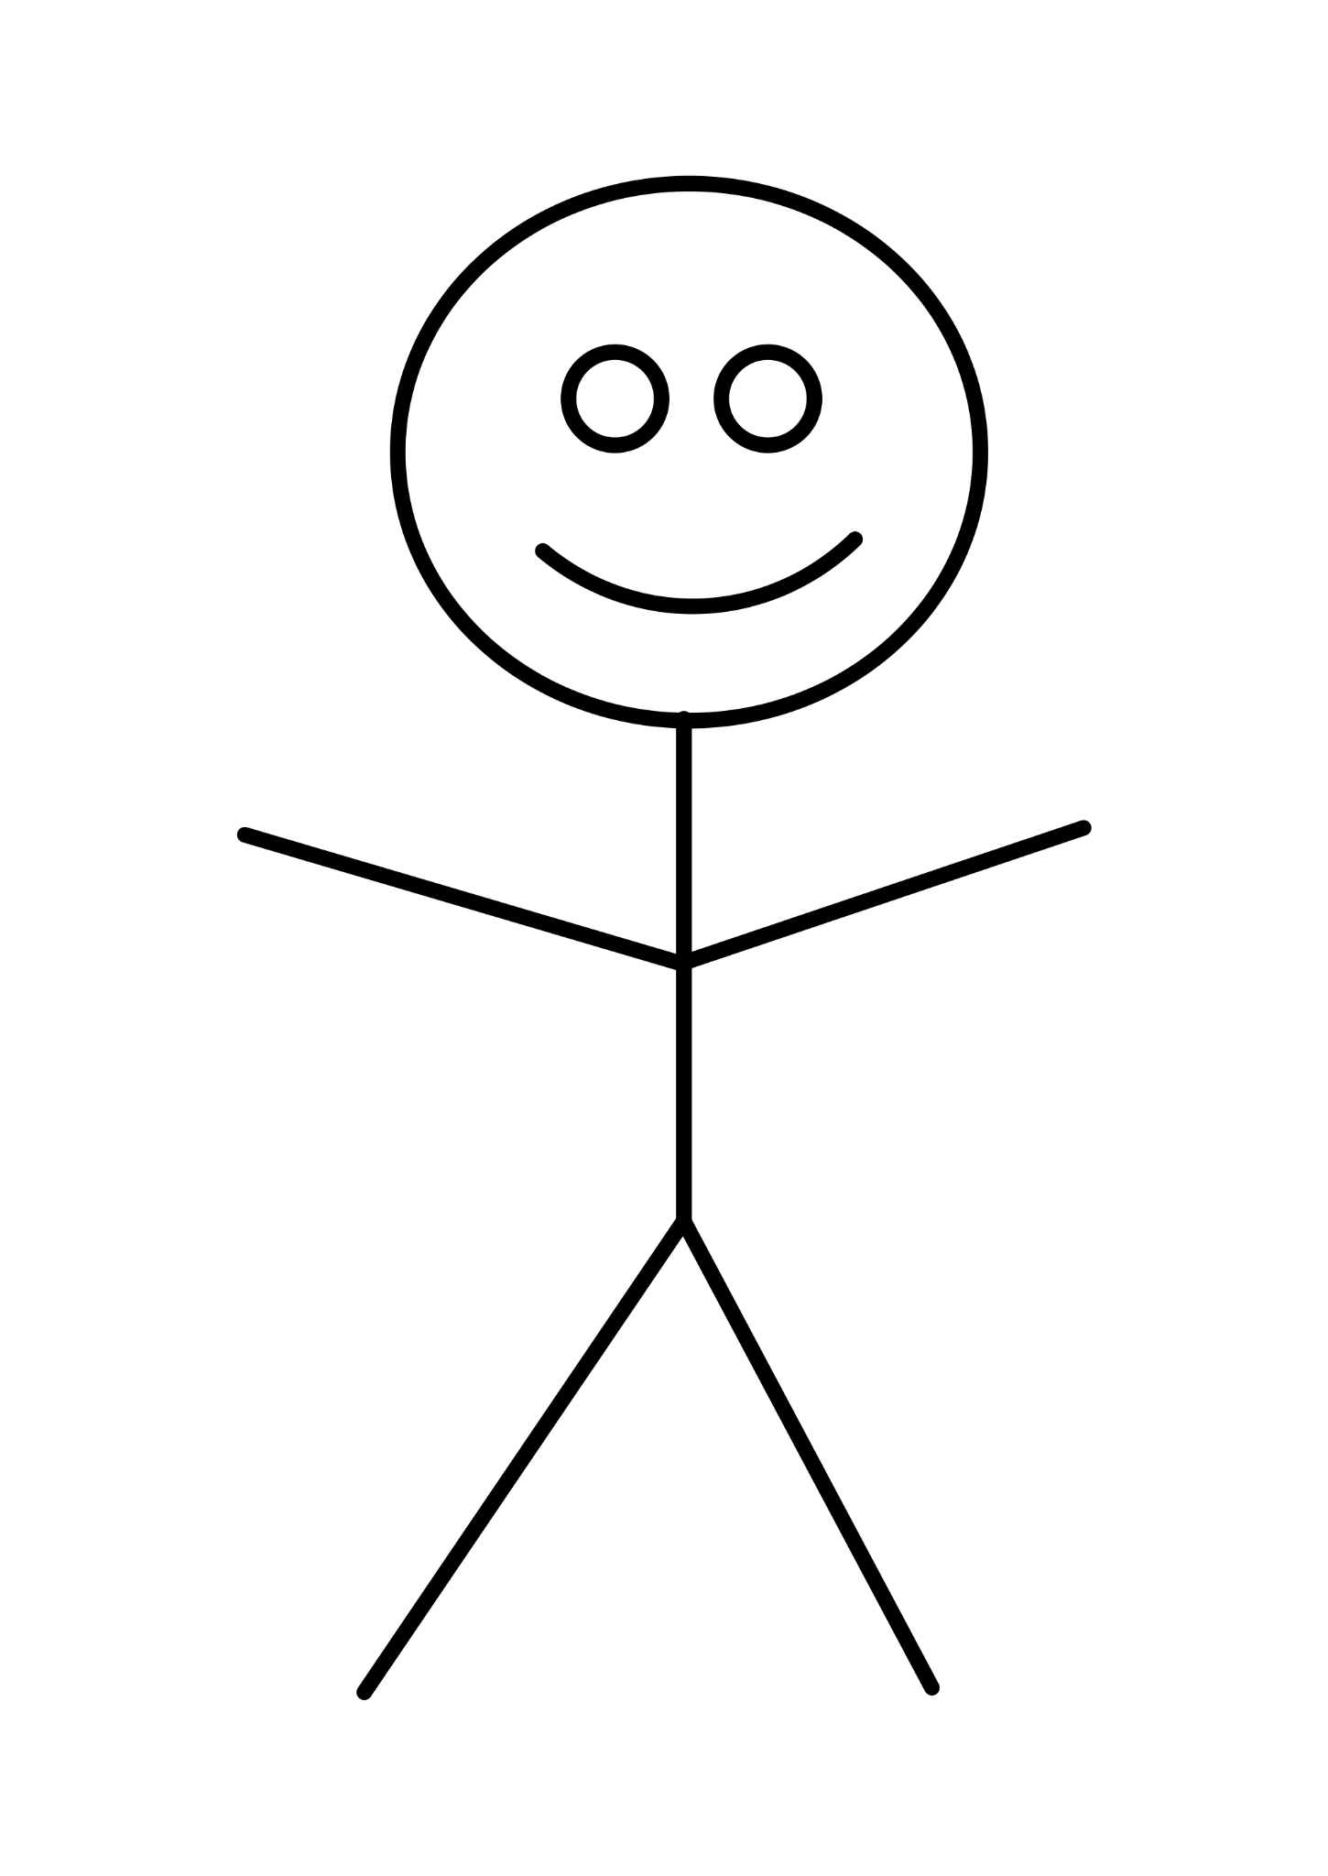
Our Goal
Our goal of this project was to receive a message in morse code through button presses and display the decoded message on a screen.
Eg. Sharing a message to a long-distance friend
…. . ._.. ._.. ___
Hello!

Slide 3
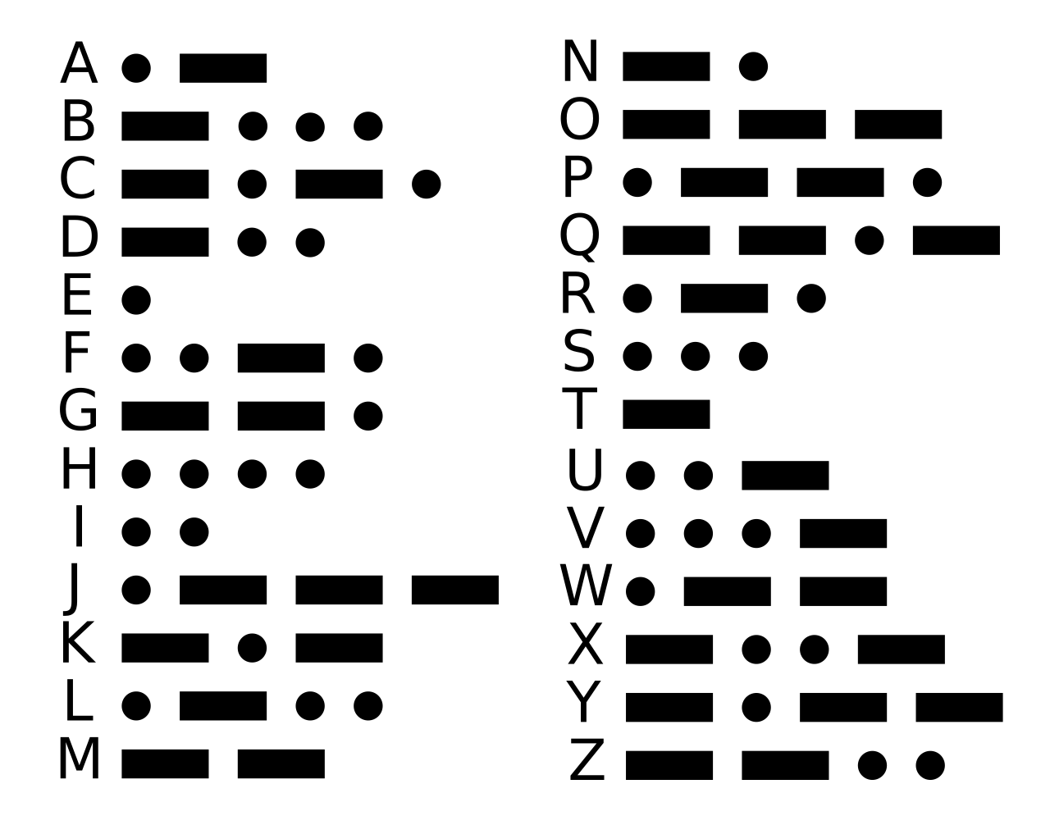
Enter your morse code message into the FPGA board
2. Decode the morse code input
DECODED
MESSAGE
3. Display the decoded message on the VGA.
Notes:
Constraints slide

Slide 4
Translator Functionality
Encoder
Decoder
Get the button input and identify each letter in morse code.
Assign each letter with its corresponding letter in the alphabet.
Display
Using the VGA, display the inputted message fully translated.

Slide 5
Block Diagram
clk
hsync
clk
clk_div
reset
DotOrDash
letter
vga_controller
vsync
video_on
x
y
clk
clk
clk
[4:0]
letterNum
[4:0]
button
[7:0]
[7:0]
[4:0]
[4:0]
row
[3:0]
[7:0]
data
ascii_rom
send
button_encoder
decoder
char_generator
vga_green
Monitor

Slide 6
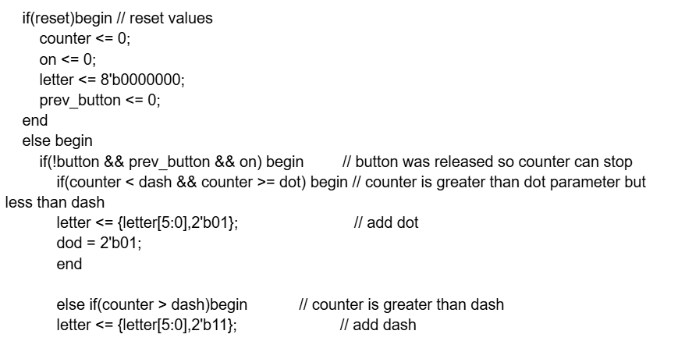
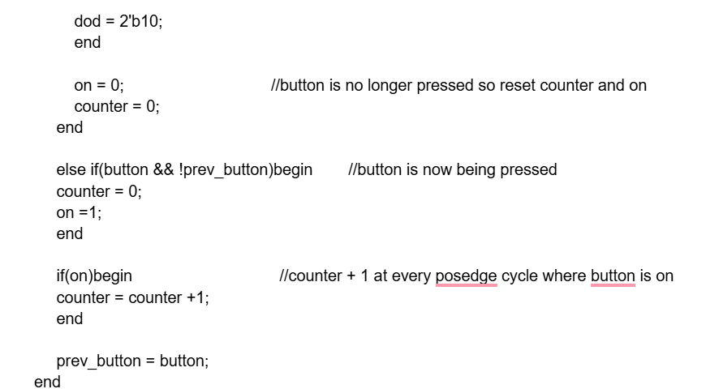
Encoder Code Snippet

Slide 7
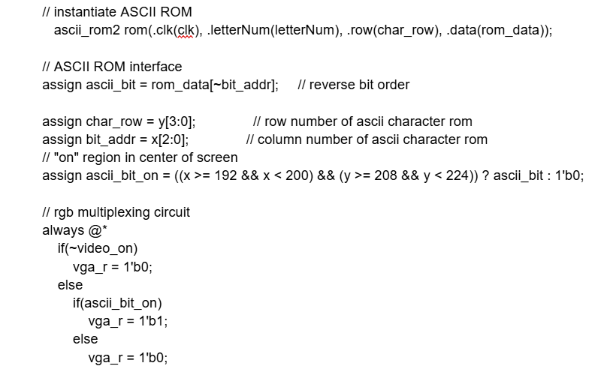
Display Code Snippet

Slide 8

Successes & Failures
Receives a series of dot and dash inputs based on the duration of button presses
Displays decoded letter on screen (works for all 26 letters)
The letters are very small
Cannot display more than one letter at a time
Decoding process is slow
What would we do differently?
Write the ASCII controller to account for larger letter size
Include more options for resetting the screen

Slide 9
Thank you!
Questions?

